Slide 1
HTML tables

Slide 2
Creating tables in html
The main tag which is used to create a table are as follows:
<table>:for starting a table .starting and ending tag is required in this case.
<tr>:for creating rows in table. starting tag is required and but ending is optional.
<th>:for giving table heading usually used in first row of table. starting tag is required and but ending is optional
<td>:which specify the data in the table. starting tag is required and but ending is optional
A small demo to show how table is created using html

Slide 3
Attributes of table tag
Align:specify the horizontal alignment of the table can be center,right and left.
Background:in which we can specify the path of the image.
Bgcolor:sets the background color of the table.
Border:sets the border width by default it is 0.
Bordercolor:we can specify the border color in this attribute.
A small demo showing usage of attributes of table tag

Slide 4
Cellpadding:sets the spacing between the cell walls and cell contents.
Cellspacing:Gives the distance between cells .
Height:Gives the height of the whole table.
Width:sets the width of the table.
A small demo showing usage of attributes of table tag

Slide 5
<TR> attributes
Align:alins the text horizontally center,right and left.
Bgcolor:gives color to the row in the table.
Bordercolor:sets the external border color of the row.
Valign:sets the vertical alignment of the text i.e. bottom,baseline and middle.
A small demo showing <tr> attributes

Slide 6
<th > Attributes
Align:horizontal alignment of the text.
Background:specify the background image for the table cell.
Bgcolor:sets the background color of the table cell.
Bordercolor:sets the external bordercolor for the cell.
Colspan:indicates how many cell columns of the table this cell should span.
Valign:vertically aligns the text in cell.
Height and width:sets the height and width of the cell
Rowspan:indicates how many rows of the table this cell should span.
these codes center the heading and set it in bold type.

Slide 7
<TD> Attributes
Td have the same attributes as the <th attribute have.
The <td> tag defines a standard cell in an HTML table.
An HTML table has two kinds of cells:
Header cells - contains header information (created with the <th> element)
Standard cells - contains data (created with the <td> element)
The text in <th> elements are bold and centred by default.
The text in <td> elements are regular and left-aligned by default

Slide 8
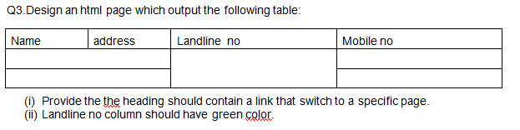

Slide 9
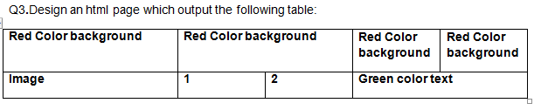

Slide 10
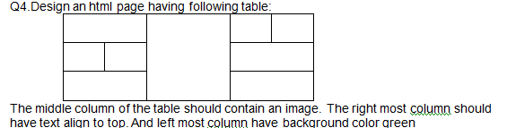

Slide 11
Design the following table
Day/time | 9-10 | 10-11 | 11-12 | 12-1 | 1-2
Monday
Tuesday
wednesday

Slide 12
Design a HTML page that contain Title:MY PAGE,Heading:welcome to my html page in red color and level should be h1.Then the page should contain three links:1)first paragraph of page2)middle of page 3)bottom of page .on the click of each link the page should switch to the portion of page ie.bottom of page should be switch to bottom.First paragraph of page should be bold and italics and font:arial and color:blue.The middle of page should contain a ordered with numbering as a),b) etc. of some items.The bottom of page should contain a image

Slide 13
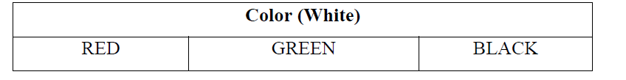

Slide 14
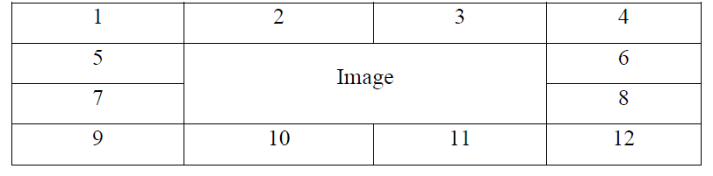

Slide 15
Create a page with a link at the top of it that when clicked will jump all the way to the bottom of the page. At the bottom of the page there should be a link to jump back to the top of the page.

Slide 16
Design an HTML Page as shown below:Font size an style is arial.
(a)Contain heading :Runner home starting of the page is such that it should contain a line of links:
HOME|RACES|RESOURCES|CALCULATOR|MYACCOUNT|LOGOUT
Each link is linked page having same name like:home is link with home.html the link should be in blue color.
(b)Below that there will be H1 level heading having text welcome to runners home after that there should be some text scrolling new attractions.
(c)Then after that heading there should be a line like_____________________________
After that there should be written 2004 runner home.All Rights reserved.like this only.

